Slide 1
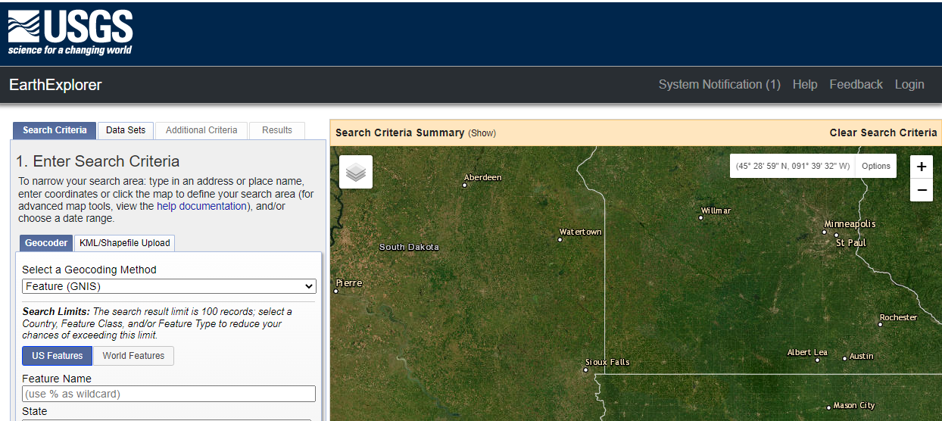
https://earthexplorer.usgs.gov/

Slide 2
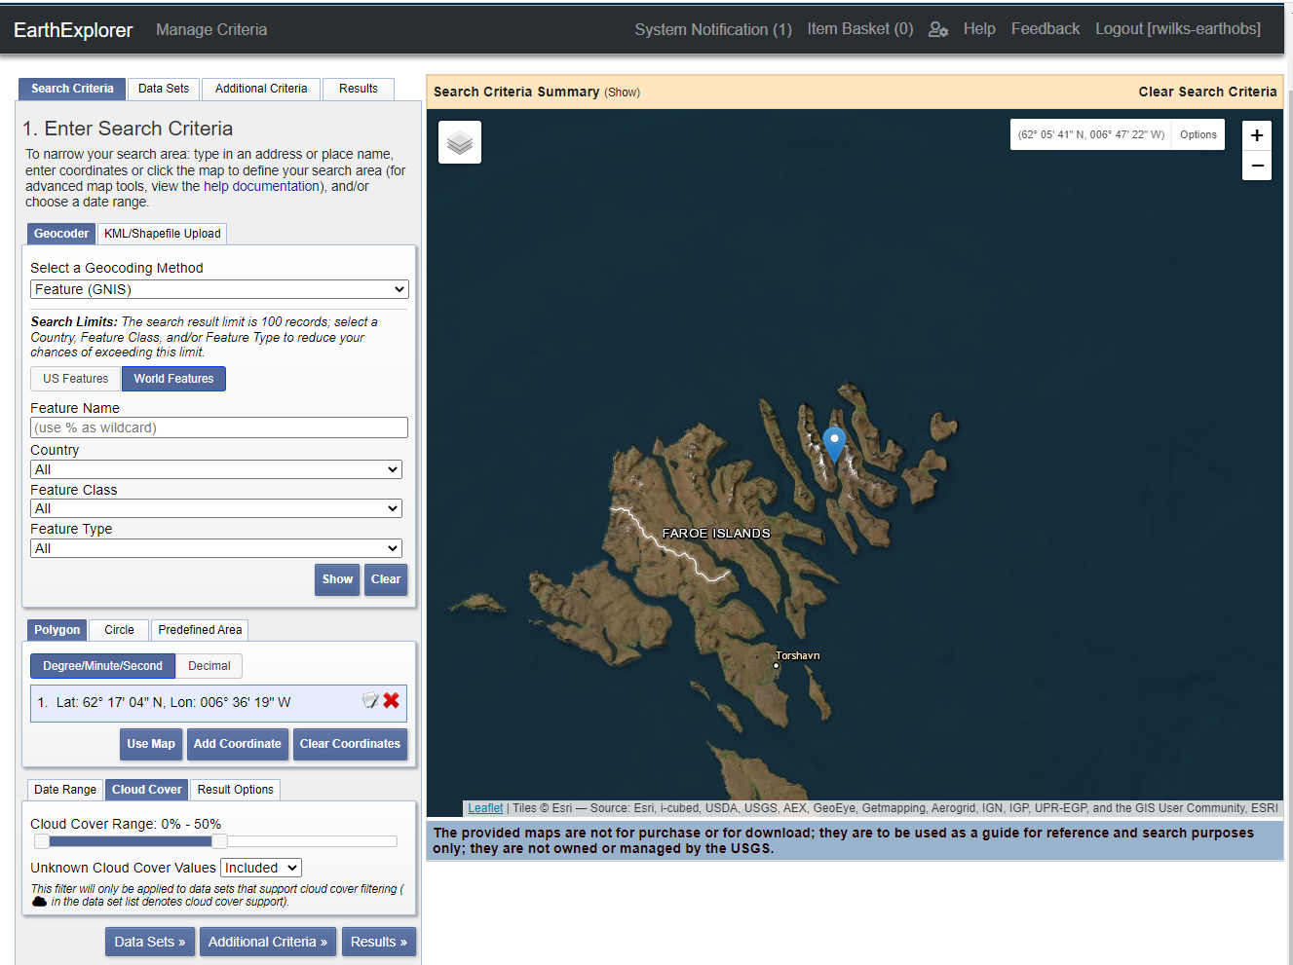
Select area of interest (AOI)

Slide 3
